Slide 1






Foundations of
Quantum Information Science (QIS 102)
Dave Biersach
Brookhaven National Laboratory
dbiersach@bnl.gov
Session 03
Introducing
Python

Slide 2
Session 03 – Part 1 of 4 – Topics
Consider Python’s Built-in Functions
Review the rules for declaring identifiers
Declare variables and use built-in data types
Review mathematical operators and precedence in Python
Display the values of variables in the output terminal using formatted strings

Slide 3
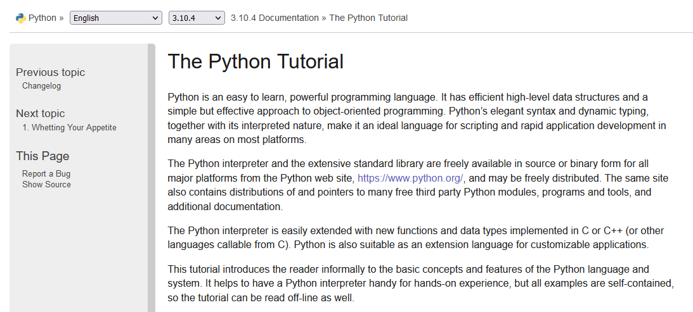
The Python Tutorial
https://docs.python.org/3/tutorial

Slide 4
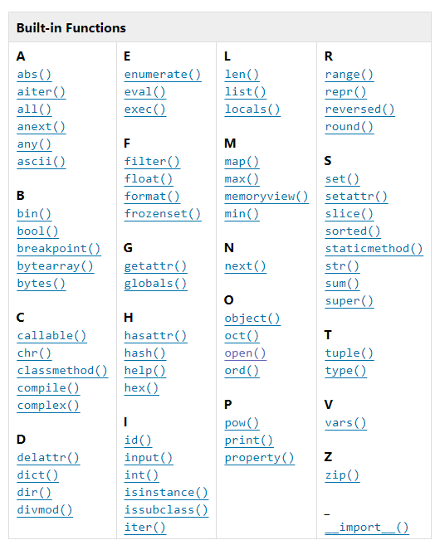
Python’s Built-in Functions
https://docs.python.org/3/library/functions.html

Slide 5
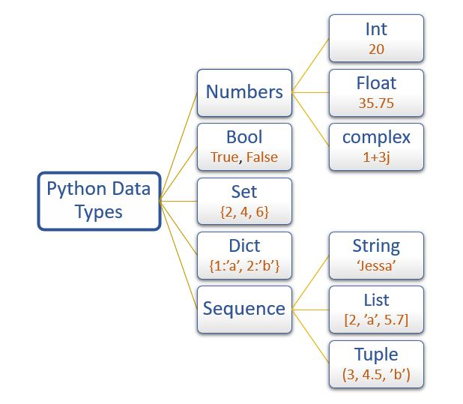
Python’s Built-in Data Types
Only
sequence types support indexed [] access
But you can use enumerate() with all of these data types

Slide 6
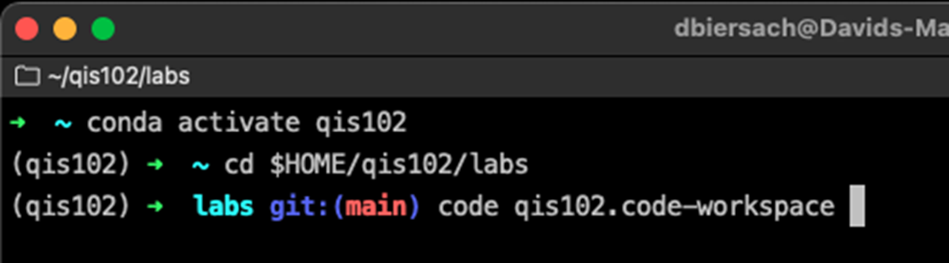
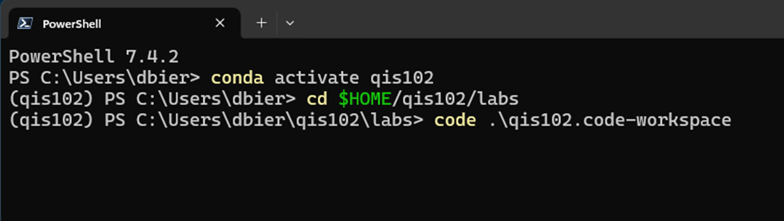
Starting Visual Studio Code
Open a terminal session, activate the QIS101 virtual environment, and launch VS Code:
conda activate qis102
cd $HOME/qis102/labs
code qis101.code-workspace

Slide 7
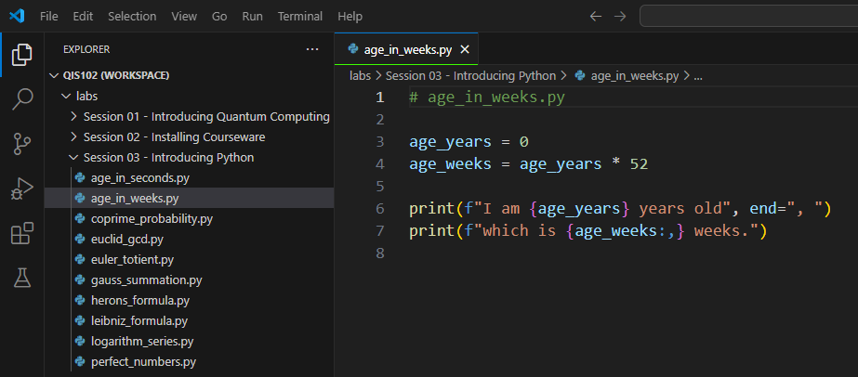
Open age_in_weeks.py

Slide 8
Identifiers
Identifiers are just names – everything in code has a name
Names must be < 64 chars in length
They can include upper- or lower-case letters and numbers
Identifiers must start with a letter and cannot contain spaces!
Three types of identifier “casing”
CamelCaseEachWord
camelCaseEachWord
all lower_case with underscores
Identifiers in Python are case sensitive!!
x is not the same as X
RARELY create ALLCAPS identifiers
(first letter is Capitalized)
(first letter is not capitalized)
(Snake case in Python!)
✓

Slide 9
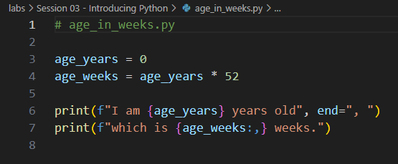
Identifiers
Source code comments start with a #
Variable
Name
An f string
A replacement field
A formatter

Slide 10
Variable Types
Variables store data in memory to be used later
Variables can be called whatever you want
Pick variable names that mean something to a human
Use snake_case (all lower case, underscores to break words)
Python supports many built-in data types for variables:
int = Stores integers only
float = Stores Real numbers with 15 digits of precision
bool = Stores True or False (Boolean logic, uppercase T/F)
str = Stores zero or more letters & numbers (a string)
Python mostly “infers” the type of a variable (0 vs. 0.0)

Slide 11
Mathematical Operators
Python operators obey normal PEMDAS precedence
Expressions are evaluated left to right in your source code
Use a single equal sign = to assign a value to a variable
Use double equal signs == to test for equality
Use * for multiplication and / for division operators
Use parenthesis to explicitly override the order of operations
Use double asterisks ** for exponentiation

Slide 12
Displaying Variables
The print() function is used to display the value of variables
When running inside Visual Studio Code, the print() output will show up in the Python TERMINAL window at the bottom of the screen
String literals must be enclosed in quotation marks (single or double)
Python can substitute a variable's value into a placeholder
To create a placeholder (aka a replacement field), you enclose the variable name between curly braces {}
Substituting variable values into replacement field(s) is called string interpolation
Placeholders can also contain format specifiers
You can specify the number of digits to the right of the decimal, etc.
You can specify left/right/center justification, column width, etc.

Slide 13
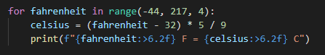
print() and f-strings
Placing a lowercase f before the first quote in a print() statement indicates you will use some placeholders
A placeholder contains the variable's name sandwiched between curly braces {}
A colon after the variable's name starts a format specifier

Slide 14
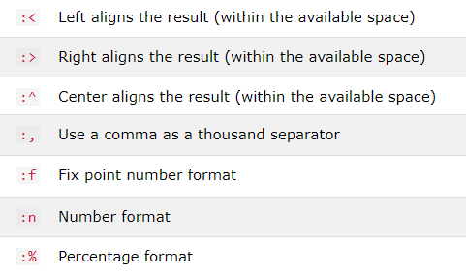
Some Common Format Specifiers
Using format specifiers is optional but makes your output more professional

Slide 15
Edit age_in_weeks.py
①
print() normally appends a line feed (\n) to the end of the output, but we can override this by specifying our desired end character(s)

Slide 16
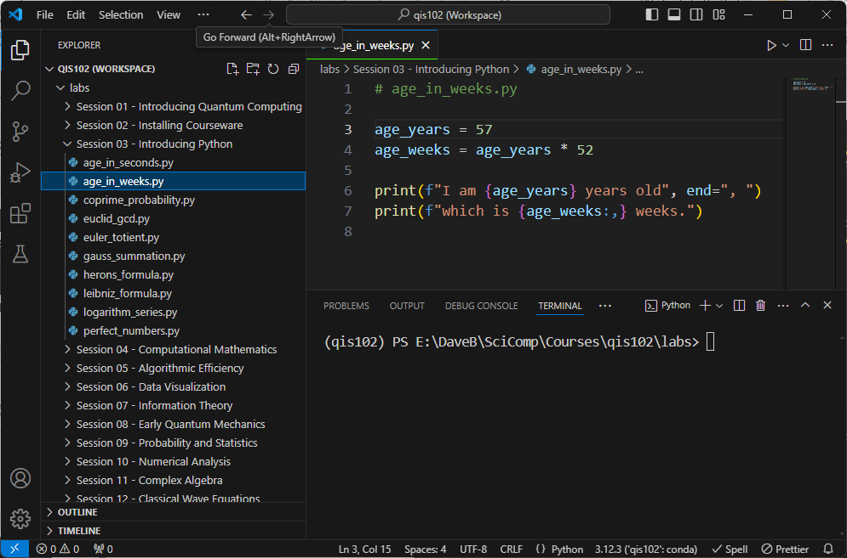
Run age_in_weeks.py
Ensure the qis102 environment is active

Slide 17
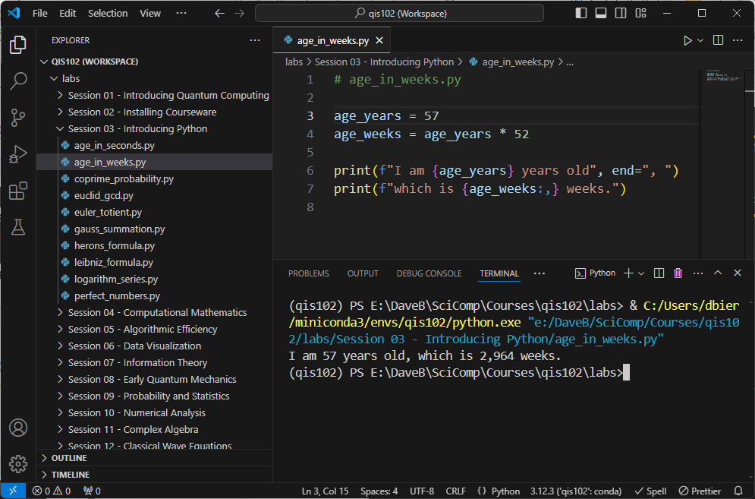
Check age_in_weeks.py

Slide 18
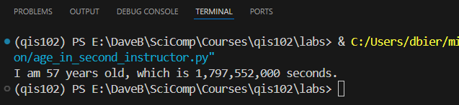
Edit then Run age_in_seconds.py
Update the Python program called age_in_seconds.py to convert your age in years to age in seconds
You can ignore leap years

Slide 19
Session 03 – Part 2 of 4 – Topics
Appreciate PEP 8 standards for source code style and auto-formatting tools like Black and Ruff
View the VS Code Workspace settings file
Understand the value of Python virtual environments
Leverage the numpy package to create arrays and perform vectorized operations on those arrays
Evaluate the convergence of the Harmonic and Basel Series
Numerically estimate the Leibniz and Logarithmic Series
Develop the functional equation for Gaussian Summation

Slide 20
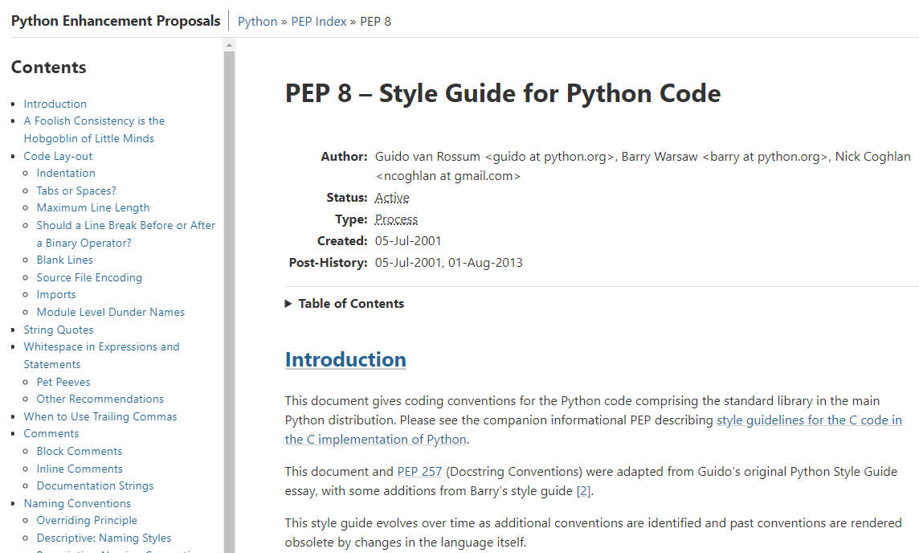
PEP 8 – Style Guide for Python Code
https://peps.python.org/pep-0008

Slide 21
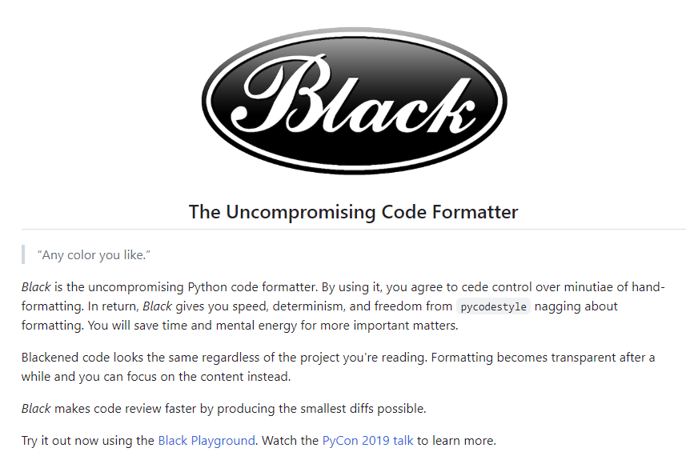
The Black Formatter
https://github.com/psf/black

Slide 22
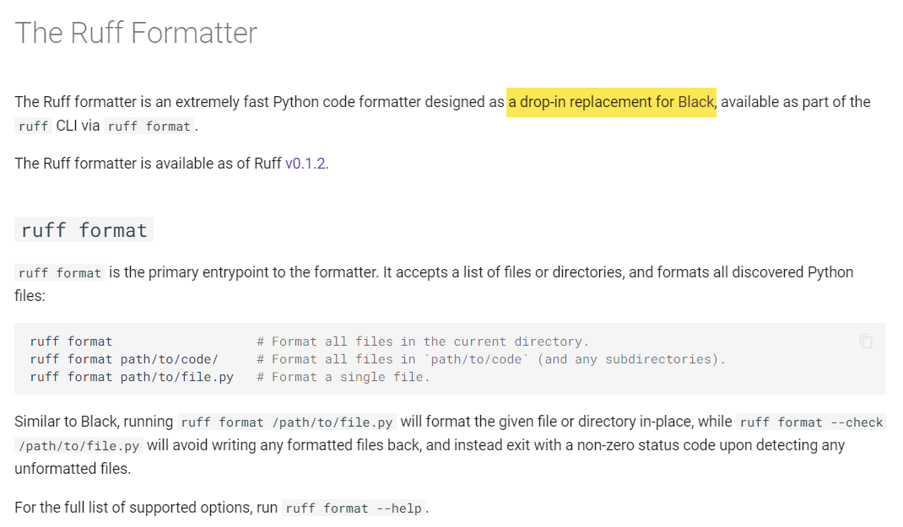
The Ruff Formatter
https://docs.astral.sh/ruff/formatter

Slide 23
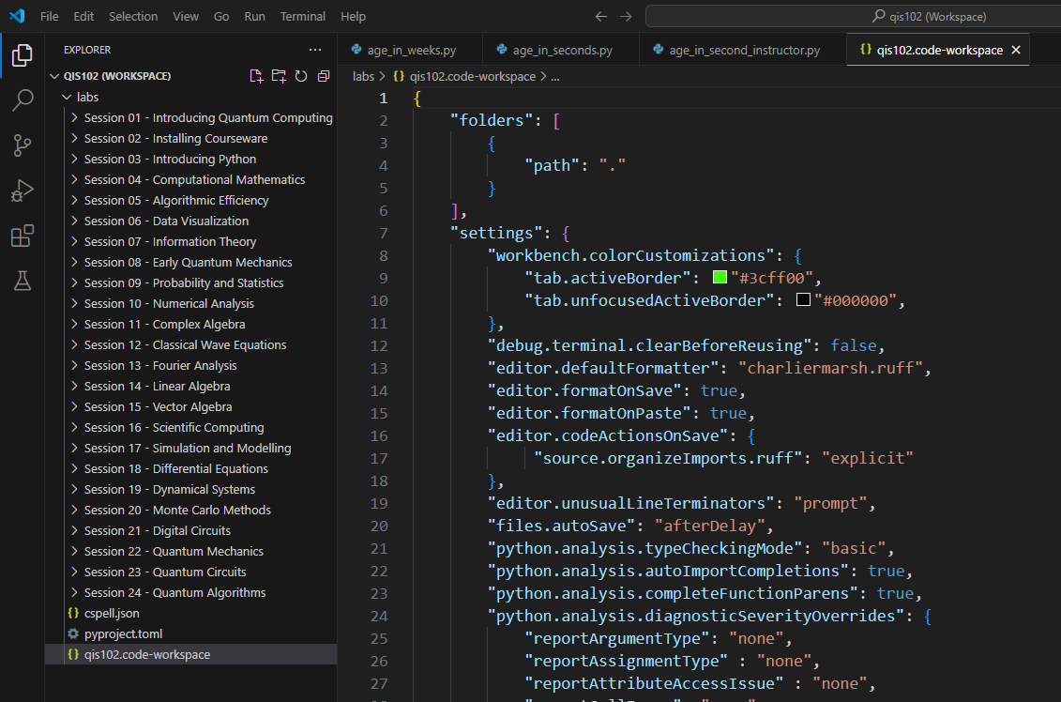
VS Code Workspace Settings File

Slide 24
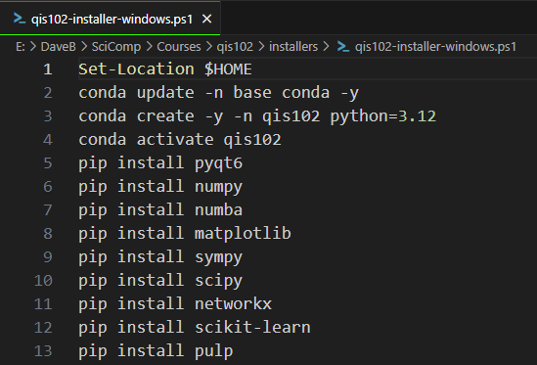
Adding Packages to a Virtual Environment
From Session 02 - Phase 2 Installer Scripts
①
②
③

Slide 25
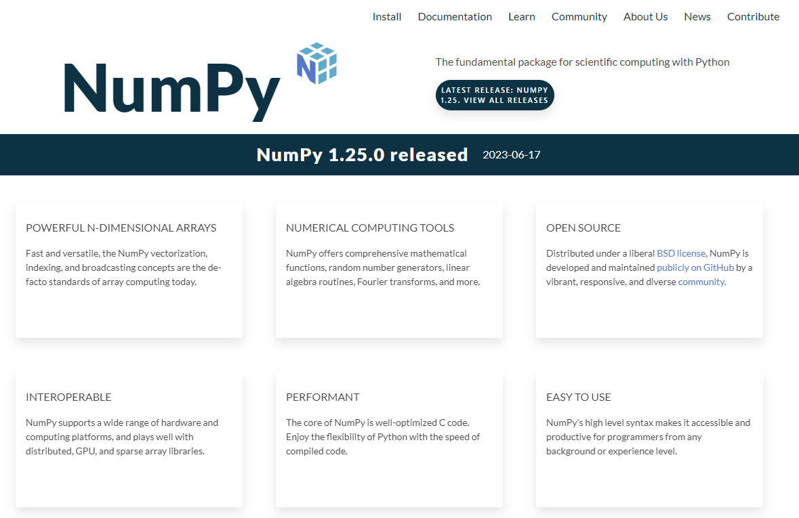
Extending Python via the numpy Package
https://numpy.org

Slide 26
Numpy Arrays
An array is a set of elements having all the same type
An individual element in an array is accessed by using its index number within square [] brackets
Every element has a unique index number
No two elements share the exact same index number
The first element has an index = 0
The function size() returns the length of an array, which is the number of elements in the array
Why is the last element in an array at [size() – 1]?

Slide 27
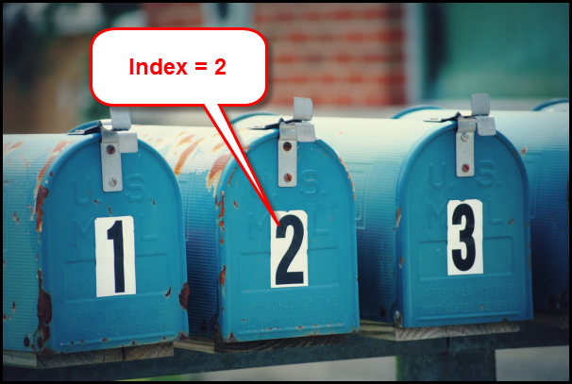

Index Number versus Element Value
array_name[2]

Slide 28
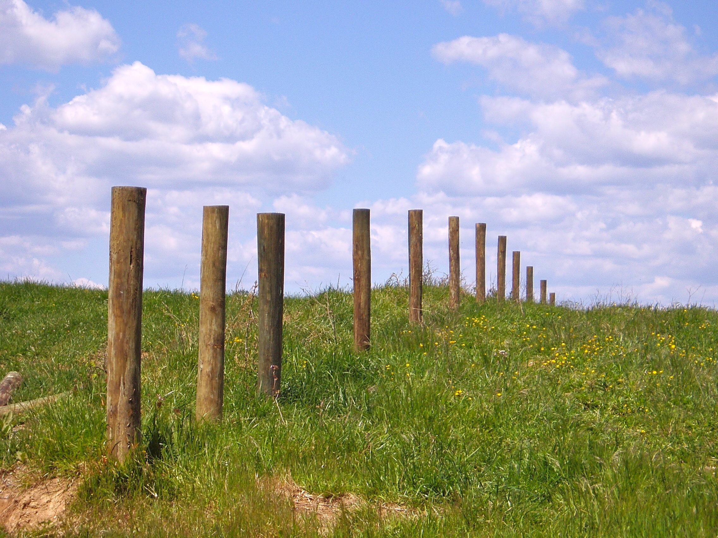
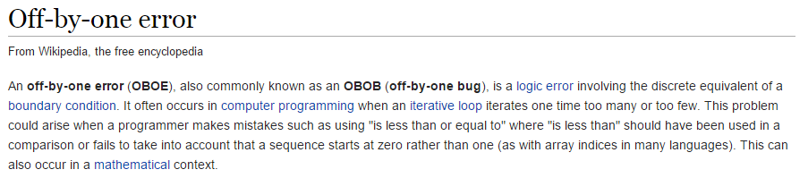
The Bane of All Programmers
This problem is why we all agree to always use ZERO as the first index value in an array.
Remember…
ZERO is a THING!
A farmer needs a fence 100m long
He wants 2m between each fence post
How many posts does he need?

Slide 29
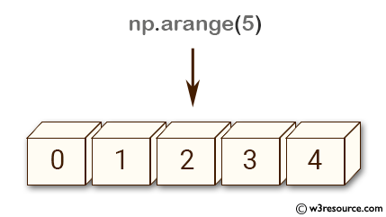
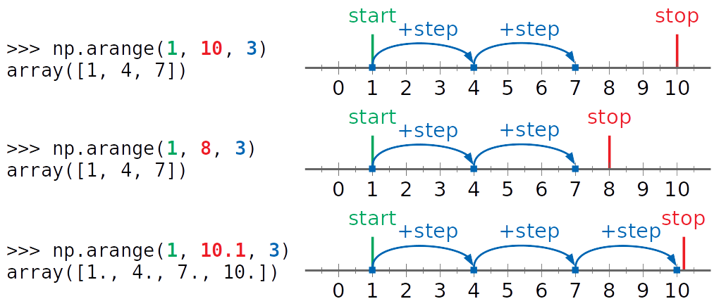
Create a Numpy Array from a Range
Creates a "street" of mailboxes where the value inside each mailbox follows the requested range
The default values are
start = 0 and step = 1
The stop value is exclusive

Slide 30
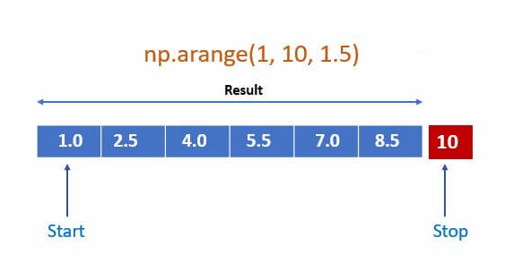
Create a Numpy Array from a Range

Slide 31
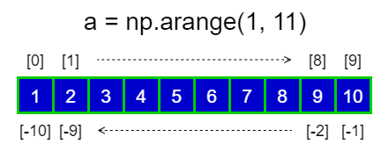
Create a Numpy Array from a Range

Slide 32
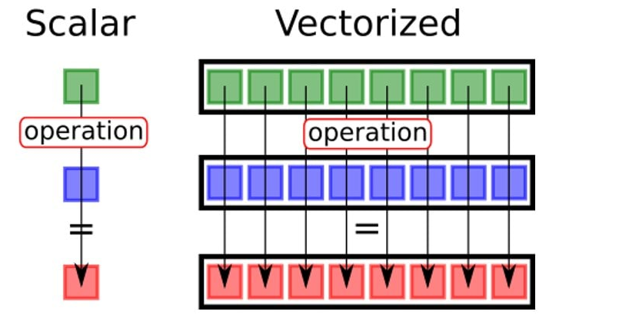
Numpy Vectorized Operations
3
a
*
*
5
b
15
a[n]*b[n]
A vectorized scalar operation applies a function to every element in a single array (to each individual cell)
A vectorized array operation applies a function to elements in both arrays that have the same index value

Slide 33
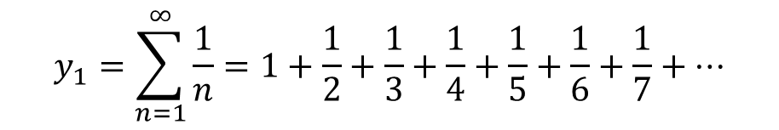
Infinite Series (Sums)
$$y_{1}=\sum_{n=1}^{∞}{\frac{1}{n}=1+\frac{1}{2}+\frac{1}{3}+\frac{1}{4}+\frac{1}{5}+\frac{1}{6}+\frac{1}{7}+…}$$
This sum is called the harmonic series
Does this series converge to a single value or diverge (grow without bounds)?

Slide 34
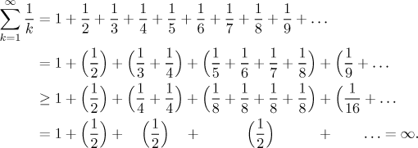
The Harmonic Series Diverges

Slide 35
The Harmonic Series Diverges

Slide 36
The Harmonic Series Diverges

Slide 37
The Harmonic Series Diverges

Slide 38
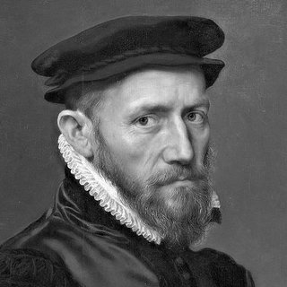
The Harmonic Series Diverges
The harmonic series diverges
Nicole Oresme (c. 1360)

Slide 39
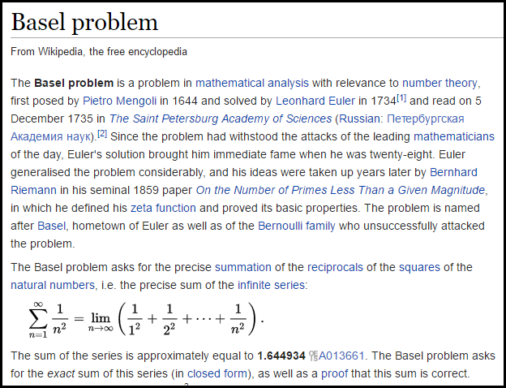

Slide 40
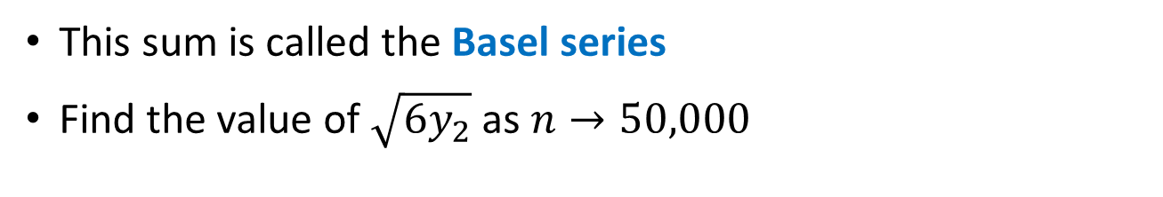
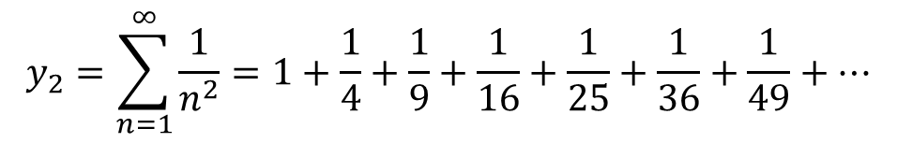
Infinite Series (Sums)
$$y_{1}=\sum_{n=1}^{∞}{\frac{1}{n}=1+\frac{1}{2}+\frac{1}{3}+\frac{1}{4}+\frac{1}{5}+\frac{1}{6}+\frac{1}{7}+…}$$
This sum is called the harmonic series
Does this series converge to a single value or diverge (grow without bounds)?
$$y_{2}=\sum_{n=1}^{∞}{\frac{1}{n^{2}}=1+\frac{1}{4}+\frac{1}{9}+\frac{1}{16}+\frac{1}{25}+\frac{1}{36}+\frac{1}{49}+…}$$
This sum is called the Basel series
Find the value of $\sqrt{{6y}_{2}}$ as $n→50,000$

Slide 41
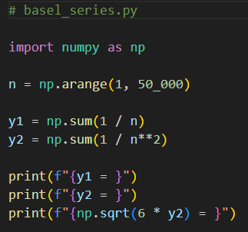
Open basel_series.py
①
②
③
④
⑤
⑥

Slide 42
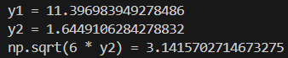
Run basel_series.py

Slide 43
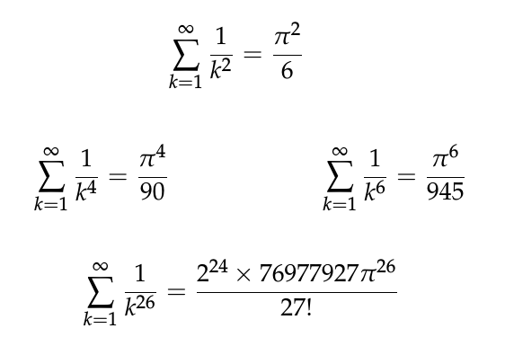
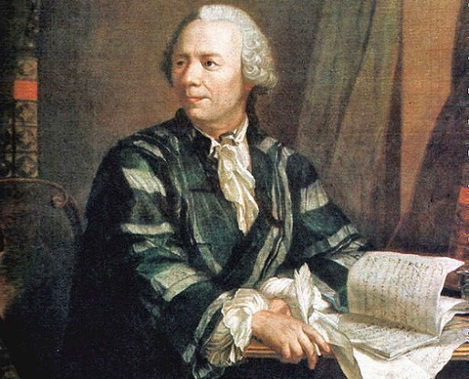
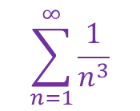
Run basel_series.py
Leonhard Euler
(1707 – 1783)
288 years later, we still do not know the exact value of
$$\sum_{n=1}^{∞}{\frac{1}{n^{3}}}$$

Slide 44
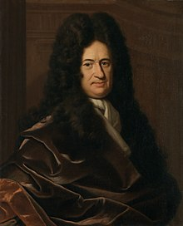
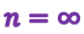
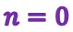
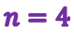
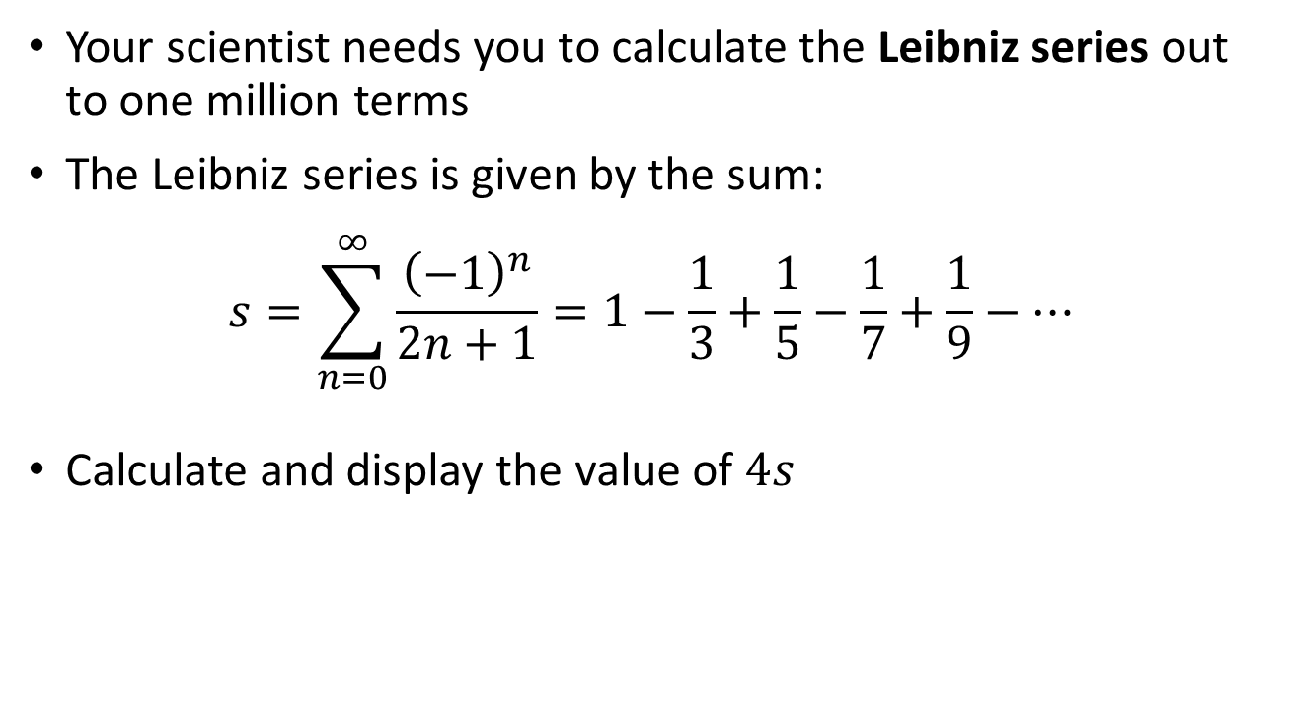
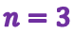
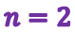
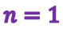
The Leibniz Series
Your scientist needs you to calculate the Leibniz series out to one million terms
The Leibniz series is given by the sum:
$$s=\sum_{n=0}^{∞}{\frac{{\left(−1\right)}^{n}}{2n+1}=1−\frac{1}{3}+\frac{1}{5}−\frac{1}{7}+\frac{1}{9}−⋯}$$
Calculate and display the value of $4s$
$$n=1$$
$$n=3$$
$$n=∞$$
$$n=0$$
$$n=2$$
$$n=4$$
Gottfried Wilhelm Leibniz
(1646-1716)

Slide 45
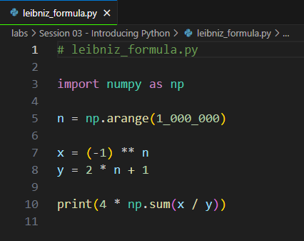
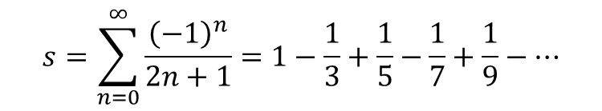
Open leibniz_formula.py
①
②
③
④
⑤
$$s=\sum_{n=0}^{∞}{\frac{{\left(−1\right)}^{n}}{2n+1}=1−\frac{1}{3}+\frac{1}{5}−\frac{1}{7}+\frac{1}{9}−⋯}$$

Slide 46
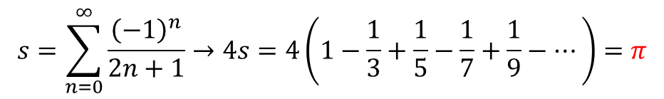
Run leibniz_formula.py
$$s=\sum_{n=0}^{∞}{\frac{{\left(−1\right)}^{n}}{2n+1}→4s=4\left(1−\frac{1}{3}+\frac{1}{5}−\frac{1}{7}+\frac{1}{9}−⋯\right)}=π$$
①

Slide 47
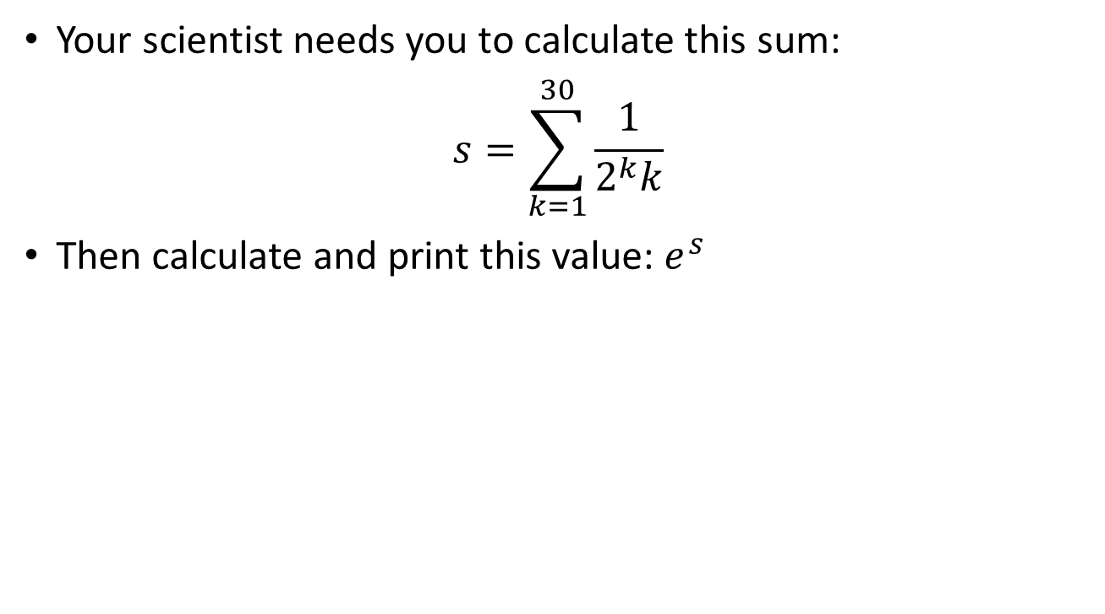
The Logarithmic Series
Your scientist needs you to calculate this sum:
$$s=\sum_{k=1}^{30}{\frac{1}{2^{k}k}}$$
Then calculate and print this value: $e^{s}$

Slide 48
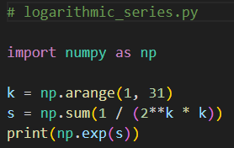

Open logarithmic_series.py
①
②
③
④
$$s=\sum_{k=1}^{30}{\frac{1}{2^{k}k}}=\frac{1}{2}+\frac{1}{8}+\frac{1}{24}+\frac{1}{64}+⋯$$
$$e^{s}= ?$$

Slide 49
Run logarithmic_series.py
$$s=\sum_{k=1}^{30}{\frac{1}{2^{k}k}}=\frac{1}{2}+\frac{1}{8}+\frac{1}{24}+\frac{1}{64}+⋯$$
$$e^{s}=2$$

Slide 50


Gaussian Summation
Carl Friedrich Gauss
(1777 – 1855)
Sum the integers from 1 to 10
1
2
3
4
5
6
7
8
9
10
1 | 9
2 | 8
3 | 7
4 | 6
5
10
n = 10
4 matched rows that each sum to 10
1 row that is = 10 / 2 = 5
1 row that is = n = 10
$$=\frac{n∗(n+1)}{2}$$
= 55

Slide 51


Gaussian Summation
Sum of first n
natural numbers:
Sum of squares of first n natural numbers:
n | n^2 | Sum
1 | 1 | 1
2 | 4 | 5
3 | 9 | 14
4 | 16 | 30
5 | 25 | 55
6 | 36 | 91
7 | 49 | 140
8 | 64 | 204
9 | 81 | 285
10 | 100 | 385
These are functional equations -
we can now calculate the sums
immediately without having to loop over every element!

Slide 52
Gaussian Summation
Your scientist needs you to demonstrate the equivalence of the Gaussian functional equation for summation versus manual term-by-term summation
Calculate the “cumulative sum” series of the first 10 natural numbers and show, term-by-term, the equivalence of these partial sums with their corresponding Gaussian summation values

Slide 53

Open gauss_summation.py
①
②
③
④
⑤
⑥
⑦
⑧
⑨

Slide 54

Run gauss_summation.py

Slide 55
Session 03 – Part 3 of 4 – Topics
Understand statements and scopes
Declare custom functions using the def keyword
Create a for loop to enumerate over a range of numbers
Use the if / else statements and Boolean Logical Operators to perform conditional code execution
Calculate the Euler Totient of an integer
Discover Perfect Numbers using the modulus operator and np.where() to select items within an array
Make a code scope run repeatedly using a while statement
Calculate the greatest common divisor (GCD) of two integers

Slide 56
Statements & Scopes
A statement does something (think: sentence)
A statement is either a declaration, a keyword, or a function
Statements are executed from top to bottom of a scope
A scope contains one or more statements (think: paragraph)
A scope in Python begins with a colon :
Scopes are also denoted via indentation
All the statements in a scope must start at the same column
Scopes can be nested – each inner scope is further indented
Certain Python statements "introduce" (require) a new scope
In Python, white space is significant – indentation matters!

Slide 57

Statements and Scopes
A for loop introduces a scope with a colon :
Nested statements inside a scope are further indented

Slide 58

Defining a function
def is how we define a function
The function name
The inbound parameter(s)
A function introduces a scope
Functions are just "named" scopes!
Functions can return a value

Slide 59

The most important function: main()
Functions are not executed (run) until they are explicitly called. The def keyword merely defines a function but does NOT run it
By convention, programmers use main() as the name of the first function they want the computer to call when starting the program
This is the first line of executable code in the program, and its sole purpose is to call your custom main() function
Your program now starts at the first statement in main()

Slide 60


for loops
A for loop executes all the statements within its scope for each number within a given range
It is common to use the range() function to create the array of numbers passed into the for statement
The range() function takes three parameters: (start, stop, step)
The stop value is required but the start and step values are optional
The default value (if unspecified) for start is 0 and for step is 1
The range is inclusive, exclusive: [start, stop)
$$⟹$$

Slide 61




for loops

Slide 62

for loops

Slide 63
if Statement
An if statement identifies which code block (scope) to run based upon the value of a Boolean expression
The expression (the condition) must evaluate to either a True or a False value
If the condition is True, then the scope immediately following the if statement is executed
If the condition is False, and there is an else clause, then the scope immediately following the else statement is executed
Every if statement does not need to have an else clause
You can also use elif to continue to test for other conditions
The if, elif, and else statements all introduce scopes (meaning they require a colon at the end of their line)

Slide 64


if Statement
def is how we define a function
Functions can return values
Be mindful of the colons : that start the scopes

Slide 65

if Statement
The break statement immediately exits from the closest enclosing loop structure

Slide 66
Euler’s Totient
Calculate Euler’s Totient for each integer between 2 and 100 inclusive
The totient of an integer is the “number of positive integers” less than the given integer that are relatively prime to that integer
Totient(12) = 4 because only {1, 5, 7, 11} are relatively prime to 12
http://www.wolframalpha.com/input/?i=totient(12)
Your program should display only those integers whose value exceeds its own totient by exactly 1
What do you notice about those integers?

Slide 67
Open euler_totient.py
⑤
⑥
⑦
⑧
⑨
②
③
④
⑩
①

Slide 68
Run euler_totient.py
What do you notice about those integers that exceed their totient value by 1?

Slide 69

while Loop
A while loop executes all the statements within its scope as long as the loop conditional remains True
The loop conditional
A while loop introduces a scope

Slide 70

The Modulus (%) Operator
The “mod” operator (%) returns the integer remainder of an implicit division operation, e.g., 37 % 5 = 2
Use double equals operator (==) when testing for equality

Slide 71


Perfect Numbers
Write a program to calculate and display all the perfect numbers n $(n∈ℤ^{+})$ between 2 and 10,000 (inclusive, exclusive)
An integer n is perfect when the sum of its proper divisors (all divisors including 1, but not including n) is equal to n
Example: 6 = 1 + 2 + 3

Slide 72

Perfect Numbers

Slide 73

Open perfect_numbers.py
⑤
⑥
⑦
⑧
②
③
④
⑨
①

Slide 74


Run perfect_numbers.py
Do you notice anything special about these numbers?

Slide 75
Perfect Numbers
Euclid–Euler theorem
$$\left\{p,\left(2^{p}−1\right) \right\}∈primes→2^{\left(p−1\right)}\left(2^{p}−1\right) is perfect$$
Note: This formula might not be the only one to generate perfect numbers – we still don't know for sure!

Slide 76

Greatest Common Divisor (GCD)
What divides A and B must also divide the difference of A - B
Why?
Given {A, B, a, b, r} ∊ ℤ
$$A=a ∗r, B=b ∗r$$
$$\left(A −B\right)=a∗r −b ∗r$$
$$a −b= \frac{\left(A −B\right)}{r}$$
∴ One can determine the GCD without having to factor either of the two integers!

Slide 77



Open euclid_gcd.py
A convenient tuple to swap two values

Slide 78

Run euclid_gcd.py
☺

Slide 79
Session 03 – Part 4 of 4 – Topics
Generate a numpy array of a request size of uniformly distributed random integers falling within a given range
Calculate the probability that two random natural numbers are coprime
Appreciate Python’s evolving approach to data “typing”
Learn about Python docstrings and how they support the Sphinx autodoc tool and “Read the Docs” web pages
Understand the purpose of anonymous variables in Python
Use the Python walrus operator to assign variables inside a conditional expression

Slide 80

Coprime Probability
Calculate the average number of times (the probability) a million pairs of random integers (1 ≤ n < 100,000) are coprime (their GCD == 1)
What does this experiment estimate to be the odds that two randomly chosen integers will share no common factors?
Find the value of $\sqrt{\frac{6}{probability}}$

Slide 81


Open coprime_probability.py
Note: If you don’t have any user-defined functions, you generally don’t need a main function
①
②
③
④
⑤
⑥

Slide 82



Run coprime_probability.py
Leonhard Euler
(1707-1783)

Slide 83




Deriving Heron’s Formula
$$s=\frac{a+b+c}{2}$$

Slide 84
Heron’s Formula
Use Heron’s Formula to calculate and display the lengths of every side and the area of 10 random triangles
The length of each side of each triangle should be a uniformly distributed random integer within [1, 100]
Use the triangle inequality theorem to exclude any invalid triangle from your list of 10
Include any degenerate triangles in your list of 10

Slide 85

Open herons_formula.py
④
⑤
⑥
⑨
⑩
①
②
③
⑦
⑧

Slide 86




Run herons_formula.py

Slide 87

Python Typing
https://realpython.com/python-type-checking

Slide 88

The Value of Docstrings
… if you include a docstring in your source code
When you hover over a function name…
…you can get a description of the purpose of the function…

Slide 89

Python’s docstrings and Sphinx autodoc
https://www.sphinx-doc.org/en/master/usage/extensions/autodoc.html

Slide 90

Read the Docs
https://docs.readthedocs.io

Slide 91
Python vs Java/C++
Python is a dynamically typed language
It is not necessary to declare the type of a variable before assigning a value to it, and a variable can change its type within a scope
In Python, a variable doesn't hold anything – a variable name is just a label for a static value
Function names are normally followed by parenthesis ()
Both functions and statements can introduce scopes using a colon :
Python is whitespace sensitive!
A scope is not enclosed in curly braces {} like in Java/C++
Horizontal indentation is how you denote scopes in Python
All statements sharing the same scope must be vertically aligned

Slide 92
Python vs Java/C++
Python is an interpreted language, not normally compiled
The reference implement of Python is CPython, which is a Python interpreter written in C
Python does not use a classical static linker – you can easily call external code residing in external modules/packages on the fly
Python code is inherently more functional (declarative) than procedural (imperative) like Java/C++
With procedural languages, you must tell the computer step-by-step how exactly to accomplish what you want
With functional languages, you tell the computer what you want to accomplish, and it determines the best way to satisfy your request

Slide 93

TASK 03-01
Create a console (terminal/text mode) Python program called celsius_to_fahrenheit.py that converts a range of temperatures in the Celsius scale to the equivalent temperatures in the Fahrenheit scale
The program should display all temperatures between ${−44}^{∘}$C and ${104}^{∘}$C inclusive in steps of $4^{∘}$C and the corresponding temperature in Fahrenheit
Each C/F pair should be displayed on its own output line, with two digits to the right of the decimal for each temperature scale
Verify the correctness of your program by checking your values for $0^{∘}$C, ${100}^{∘}$C, and ${−40}^{∘}$C
Upload your solution to the BNL QIS102 SharePoint site

Slide 94
TASK 03-02
Create a program sum_squares.py to sum the first 1,000 natural numbers squared
Verify the loop sum by also displaying the value calculated using the functional equation for Gaussian summation
Format the output of the two sums using a comma as the thousand's separator
Upload your solution to the BNL QIS102 SharePoint site

Slide 95

TASK 03-03
Create a program sum_multiples.py to display the sum of all natural numbers less than 1900 that are divisible by both 7 and 11
Upload your solution to the BNL QIS102 SharePoint site

